Slide 1
Intermittent fasting
Nick LaToof

Slide 2
First things first
As individuals we see things through a specific lens. It has to do with our background.
How & Where We Grew Up
Individual Passions/Biases
Spoon-Fed in Undergrad Program
Body Composition/ Performance
Notes:
However, looking through this through a sports prospective can help us greatly in understanding how it will benefit average Jane/Jon Doe. Just as we get our vehicle technology from NASCAR, so we can learn many things by looking at the extremes.

Slide 3
What it is
Alternate way of eating
Changes when you eat
More of a method/strategy
Lifestyle

Slide 4
What it is not
Magical window
Type of diet
Change what you eat (although in some cases it should)

Slide 5
The theory
Benefits of Fasting
Increased oxidation of fat
Detox of blood
Short term boost in Metabolic Rate
Improved Blood Lipids
Better:
Insulin Sensitivity
Increased GH
Anabolic Response to Meals
Other:
Decrease in caloric consumption
Notes:
Clarify fasting and starvation. Big difference!

Slide 6
If breakdown
Fasted-State
Fed-State
No calorie consumption
Water
Non-Caloric Beverages
Diet sodas, coffee,
BCAA Supplementation
You are to consume all of your calories in a set time frame
Number of meals is not important
Typically 3
Largest Meal Post-Workout
When is my eating ‘window?’

Slide 7
Adherence

Slide 8
IF Variations
Alternate Day Fasting
Warrior Diet
24 hrs fasted
24 hrs fed
People can do these every other day
Most start slow and begin with one 24 hr fast per week
Popularized by Brad Pilon’s Book “Eat Stop Eat”
1 large meal/day
Usually comes at night
Humans are nocturnal eaters
“under eat” throughout the day
Nuts/fruits/veggies
Notes:
I do not recommend this 24 hr approach but not because it’s not affective. It works rather well and many have seen great results off of it.

Slide 9
Variations of IF
Man 2.0
Lean Gains Approach
8 hr eating window
16 hr fasting window
Cheat meal every week
Must fast the day after
Small meal okay
8 hr eating window
16 hr fast
Women 10/14
Higher carb intake on workout days
Higher fat intake on non-workout days
Popularized by Martin Berkhan
LeanGains.com
“Founder” of Intermittent Fasting

Slide 10
Most affective
The Terms
Gaining Muscle & Strength
Losing Fat
Easiest to Follow
The Protocol
LeanGains Protocol
Skip “Breakfast”
Eat Later in the day, before bed
Calorie/ Macronutrient Cycling

Slide 11
Common arguments against if
Fasting & “Starvation Mode”
Greater Meal Frequency Keeps Metabolism High
Fasting Causes Muscle Loss
Skipping Breakfast Makes You Fat
No Energy with Fasted Training

Slide 12
fasting
Cahill study
Subjects fasted for 1 week
Blood glucose levels dropped & leveled after day 3
Better insulin response
Fatty acid utilization higher (in presence of glucose)
Reduction in Nitrogen loss (decreased gluconeogenesis)
TAKE HOME:
Metabolic balances demonstrated the predominance of lipid as fuel and decrease metabolism of glucose which, in turn, spared nitrogen stores, decreasing gluconeogenesis
Notes:
Cahill took 6 normal subjects with no diabetes and eating a diet that was greater than 250g of carbohydrates, 80g of protein, and variable amounts of fat
2 subjects were diabetics.
Subjects were tested before fast began and afterwards on their response to a glucose tolerance test.

Slide 13
Fasting
Liaoliao et al
Decreased oxidative stress in the brain
Increased cognitive function
Not exactly known why
Speculation:
Not constantly thinking about food all day
Notes:
Found that chronic intermittent fasting decreases oxidative stress in the brain. Study was done in rats’ ability to complete maze.
The market has been so flooded with 6-8 meals a day. People hear this and think they cannot be successful if they do not fit into that protocol.

Slide 14
fasting
Stewart and Fleming
382 days of fasting
Maintained normal weight
Blood glucose remained stable after initial drop
Glucose tolerance remained normal upon re-introduction of CHO
“Prolonged fasting in this patient had no ill-effects”

Slide 15
Meal Frequency & Metabolism
Thermogenic Effect of Food
Rate of Digestion/Absorption
Some Studies Show that Lower Meal Frequency Has Greater Affect on Satiety
High Metabolism is Correlated with Lower BF %
What’s the Goal?
High Metabolism
Lower BF %

Slide 16
Muscle loss with fasting
Short-Term Fasting Has No Affect On Cortisol Levels
Ramadan Studies
Misunderstood Role of Cortisol
Digestion/Absorption slower than most realize
If still worried, BCAA supplementation is okay

Slide 17
Skipping breakfast
There is nothing inherently good or bad about breakfast
Correlational Studies
Why Breakfast May Make You Hungry
CAR & Insulin Combo
http://www.nicklatoof.com/the-basics-of-breakfast/

Slide 18
Fasted training
Ramadan Studies
Aziz et al
Small, significantly negative impact on running endurance although it varies between individuals
Important Notable: Fluid Restriction
Weight Training Much Less Impacted
Knapik et al
Concluded that there are minimal impairments in physical performance parameters measured here as a result of a 3.5 day fast.

Slide 19
Non-physiological benefits
Large, more satiety meals
Not thinking about food all day
Meal prep much easier

Slide 20
notables of importance
Does not create “magical window”
Differing approaches for different lifestyles
Can be implemented safely
LaToof recommended

Slide 21
Does it work?

Slide 22
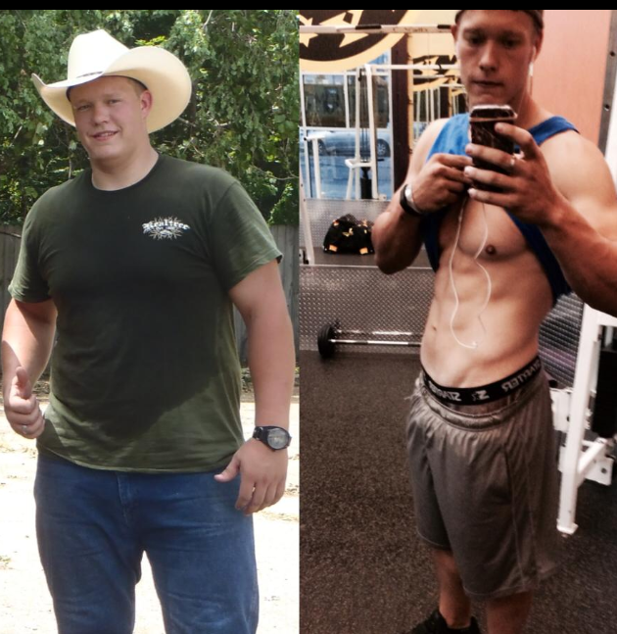

Slide 23
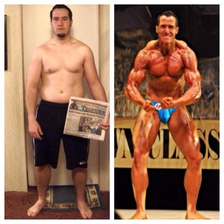
Photos Courtesy of www.nicklatoof.com all rights reserved.

Slide 24
Intermittent fasting could be for you!
Prefer to eat larger meals
Looking to optimize body composition
Not a big “breakfast” eater

Slide 25
Works cited
Aziz, A.R.,Wahid, M.F., Png, W., and Jesuvadian, C.V. (2010). Effects of ramadan fasting on 60 min of endurance running performance in moderately trained men. British Journal of Sports Medicine 44(7): 516-521. doi: 10.1136/bjsm.2009.070425
Berkhan, Martin. (2010). Top ten fasting myths debunked. Leangains.com. http:// www.leangains.com/2010/10/top-ten-fasting-myths-debunked.html.
Cahill, G.F., Herrera, A.P., Morgan, J.S., Soeldner, J., Steinke, P.L., Levy, G.A. Reichard, Jr., and Kipniss, D.M. (1966). Hormone-fuel interrelationships during fasting. Journal of Clinical I nvestigation 45:11, 1751-69. doi: 10.1172/JCI105481
Knapik, J.J., Jones, B.H., Meredith, C., and Evans, W.J. (1987). Influence of a 3.5 day fast on physical performance. European Journal of Applied Physiology and Occupational Physiology 56(4): 428-432.
Liaoliao, L., Wang, Z., and Zuo, Z. (2013). Chronic intermittent fasting improves cognitive functions and breain structures in mice. PLoS One 8(6). doi: 10.1371/journal.pone. 0066069
Stewart, W.K., and Laura. W. Fleming. (1973). Features of a successful therapeutic fast of 382 days’ duration. Postgrad Medicine Journal, 49(569): 203-209.

